Slide 1

Practical examples of accelerating numerical and ML research with Julia
Jamie Mair (School of Physics & Astronomy)

Slide 2
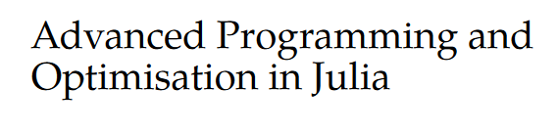
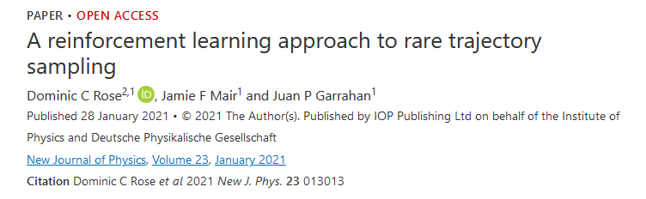
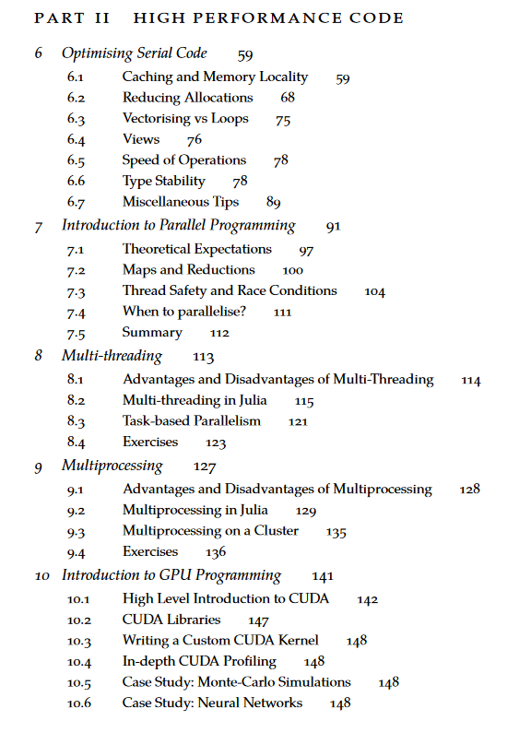
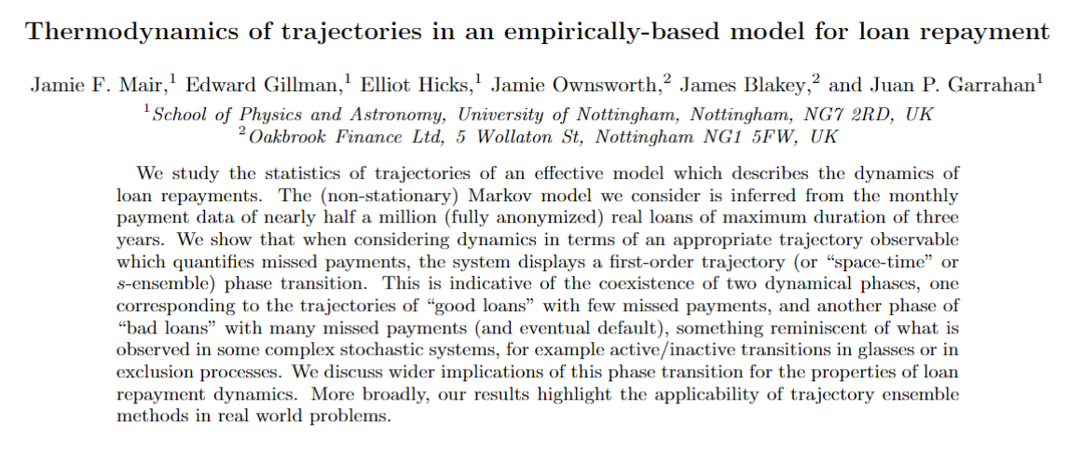
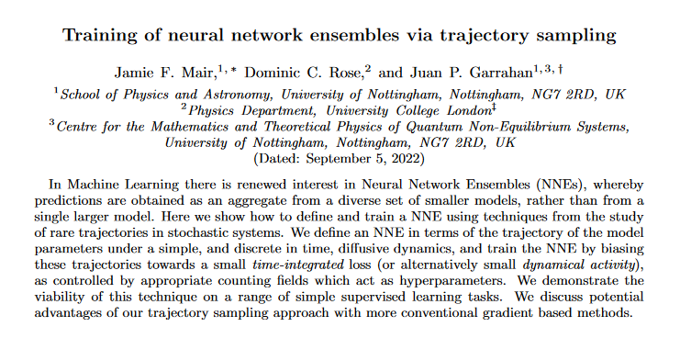

Who am I?
Notes:
Work is at the interface between Machine Learning and Statistical Mechanics
Reinforcement Learning with rare trajectory sampling -> translates a large deviation problem into a reinforcement learning problem. RL requires an interative process of generating simulation data with a model and then processing and training on that data. Can require 10s of millions of epochs, with each epoch requiring hundreds of thousands of calculations. This is then usually repeated many times.
Using machine learning models with transition path sampling, which need to run for a long time, and many repeats to study a spectrum of a parameter.
Some external work with a finance company, applying machine learning methods to real world data.
Some other work, such as applying reinforcement learning in quantum circuits.
Working on a postgraduate level “MPAGS” model which focuses on teaching a basic level of high performance computing to new PhD/Masters level students using Julia
Most of the techniques applied require a large scale to work, and to research. One needs to often see how a system behaves under varying parameters, involving a lot of randomness, so most results require large numbers of repeats. Most applications need to be able to scale to run on a cluster or at least a GPU. Most code is custom, and does not always have a package that will do what you want.

Slide 3
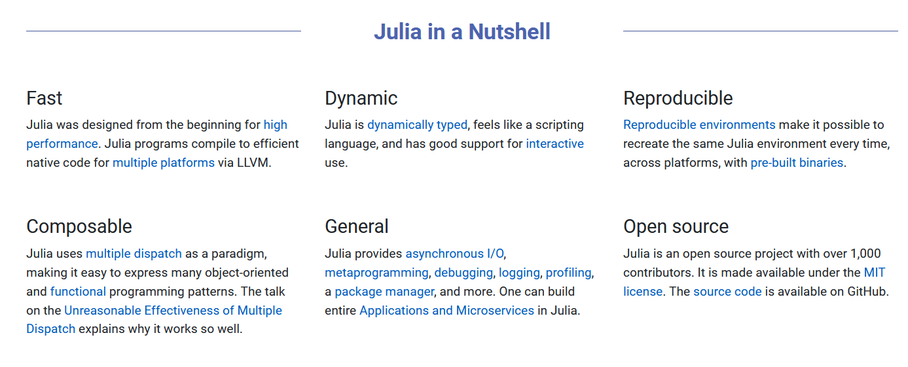
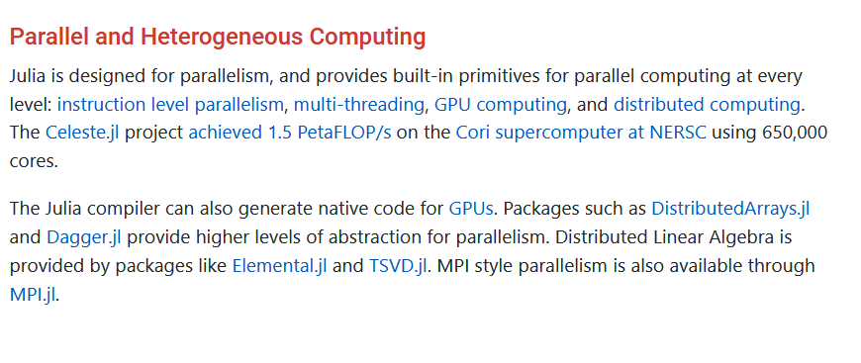

What is Julia?
https://julialang.org/

Slide 4
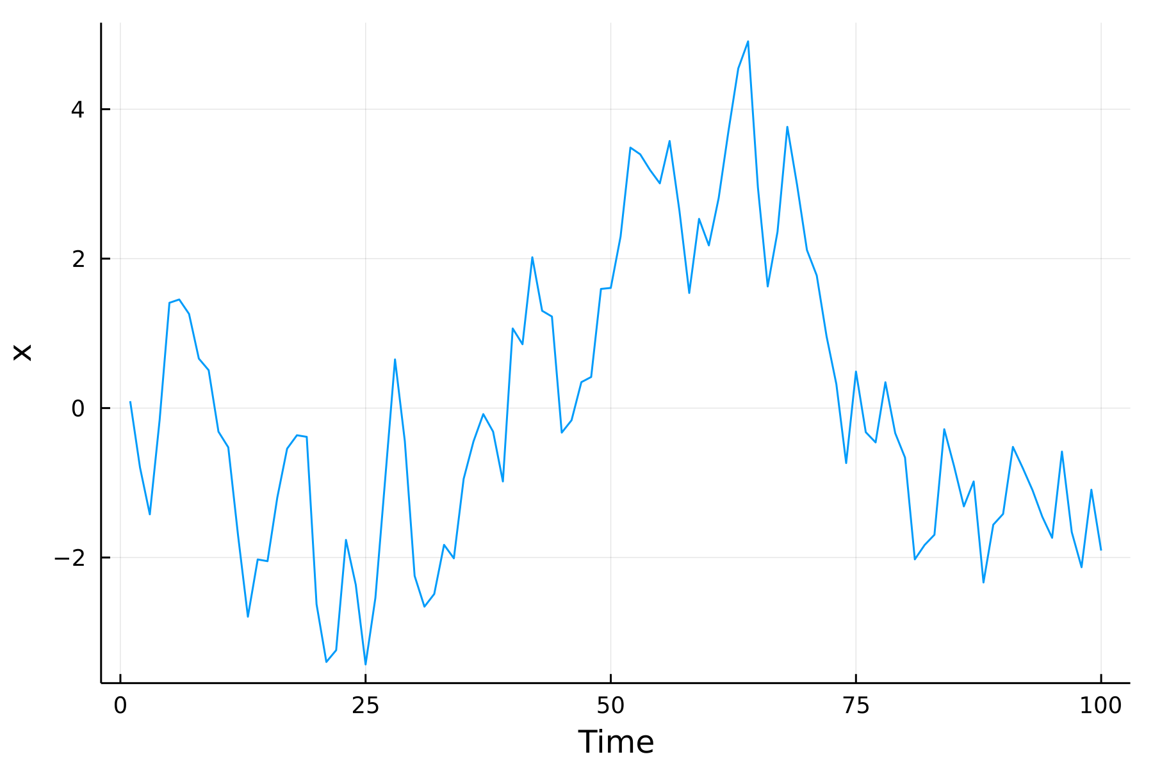
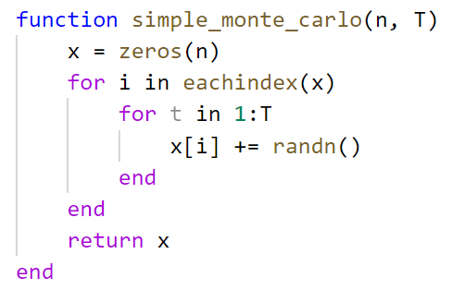
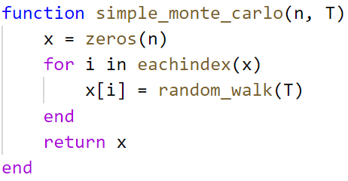

“Embarrassingly Parallel” Monte Carlo
Random walk of a single particle over a number of discrete time steps.
We want to get $n$ samples of the final position of the walk after $T$ time steps.
Simple problem allows us to explore different types of parallelisation.
Generic independent function

Slide 5
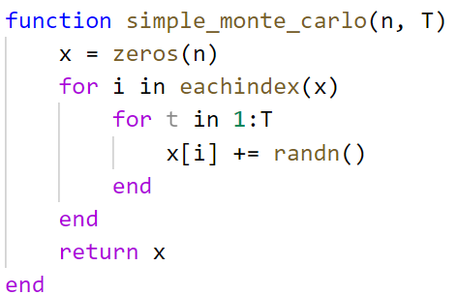
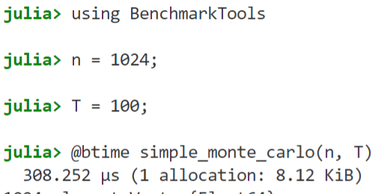
Code Overview
# Allocates an array with n elements
# Iterate through all indices of the array
# Loop over all time steps (T)
# Add a Gaussian random number to the element
# Return the array

Slide 6
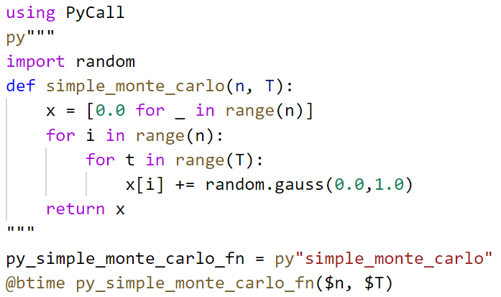

Is it fast? (vs native Python)
~150 times faster****

Slide 7
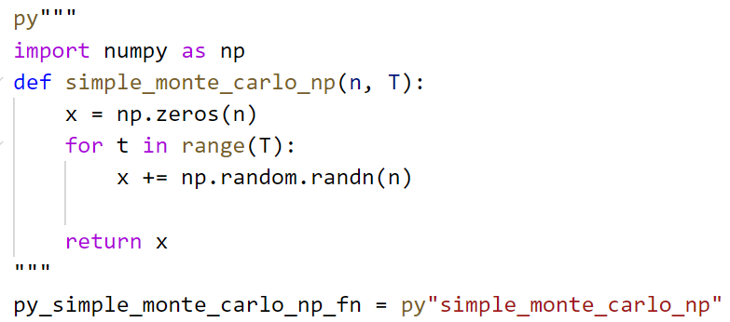

Is it fast? (vs numpy)
~7 times faster****

Slide 8
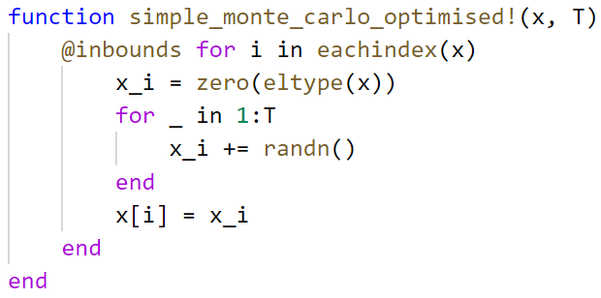
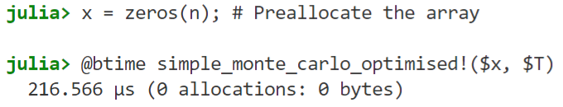
Can it be faster?
~1.4x faster

Slide 9
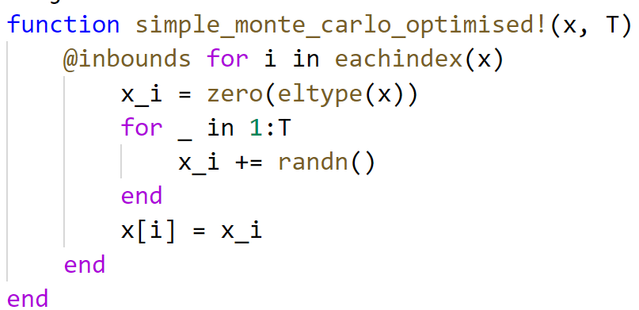
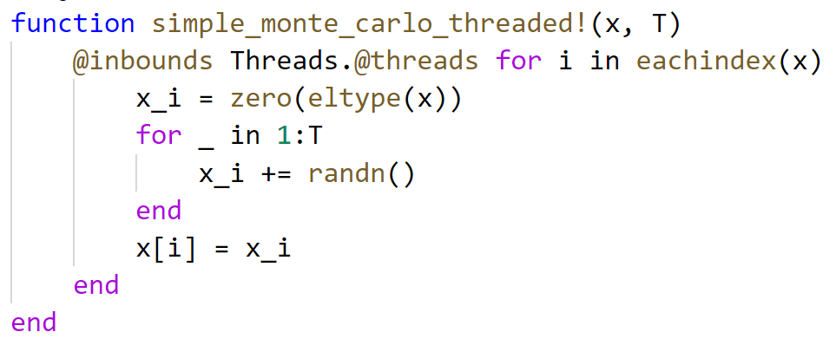

Using multiple cores
~4.7 times faster, using 8 cores

Slide 10
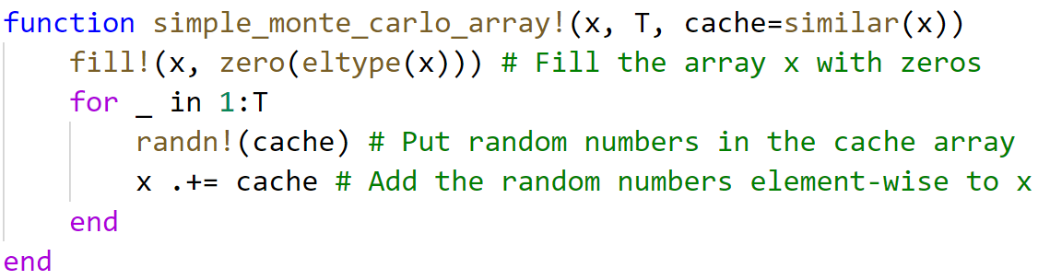
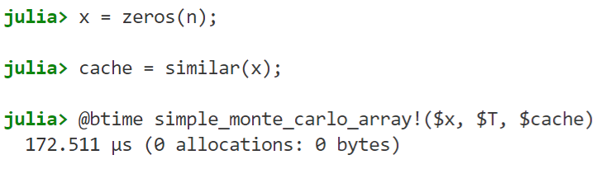
What about “vectorisation”?
~1.25 times faster (single core)

Slide 11
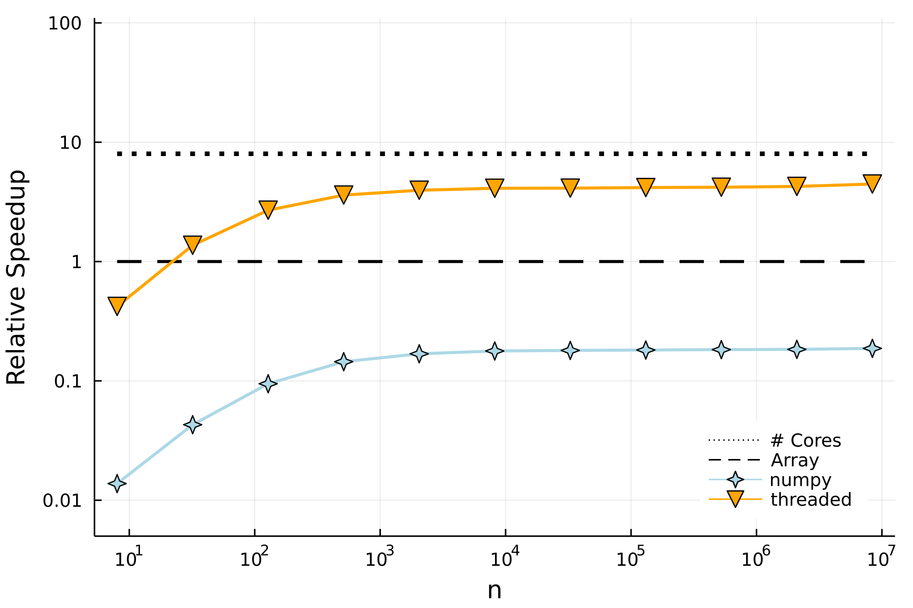
Relative Performance
~4.5x faster
~7x slower

Slide 12
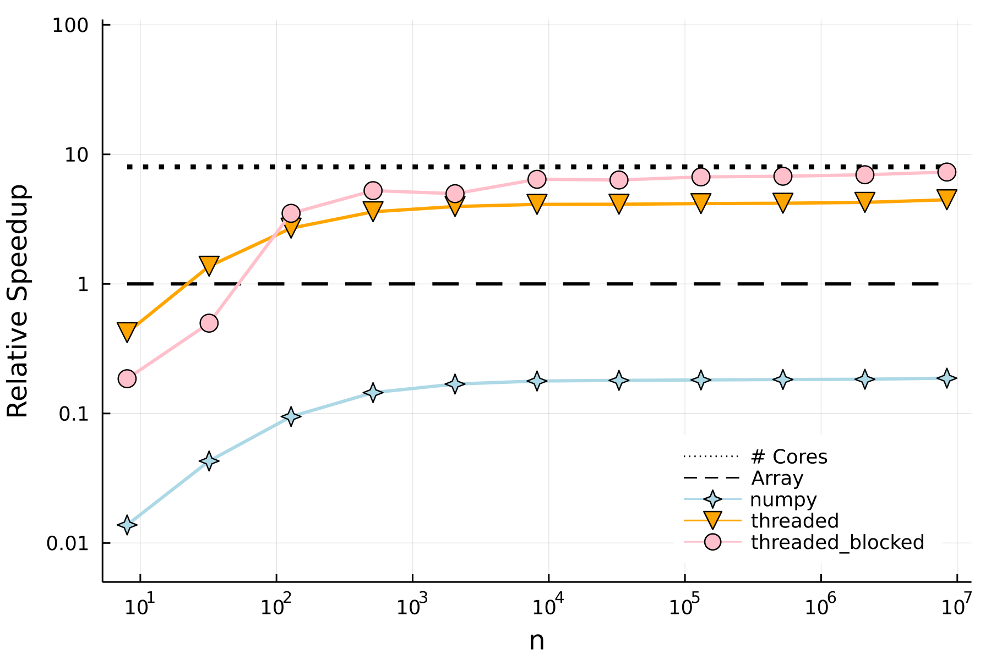
Relative Performance
Solution:
Reduce scheduling by chunking the threaded parts into blocks.
This also keeps memory access patterns predictable so better cache optimisation

Slide 13

Using a GPU
Same “vectorised” code as before
Only the input types changed, and Julia compiled a GPU version of the function.
There’s a catch, uses Float32 by default.
About 1.4x slower than CPU using Float32.
GPU is usually slower than a CPU, unless the workload is large enough.

Slide 14
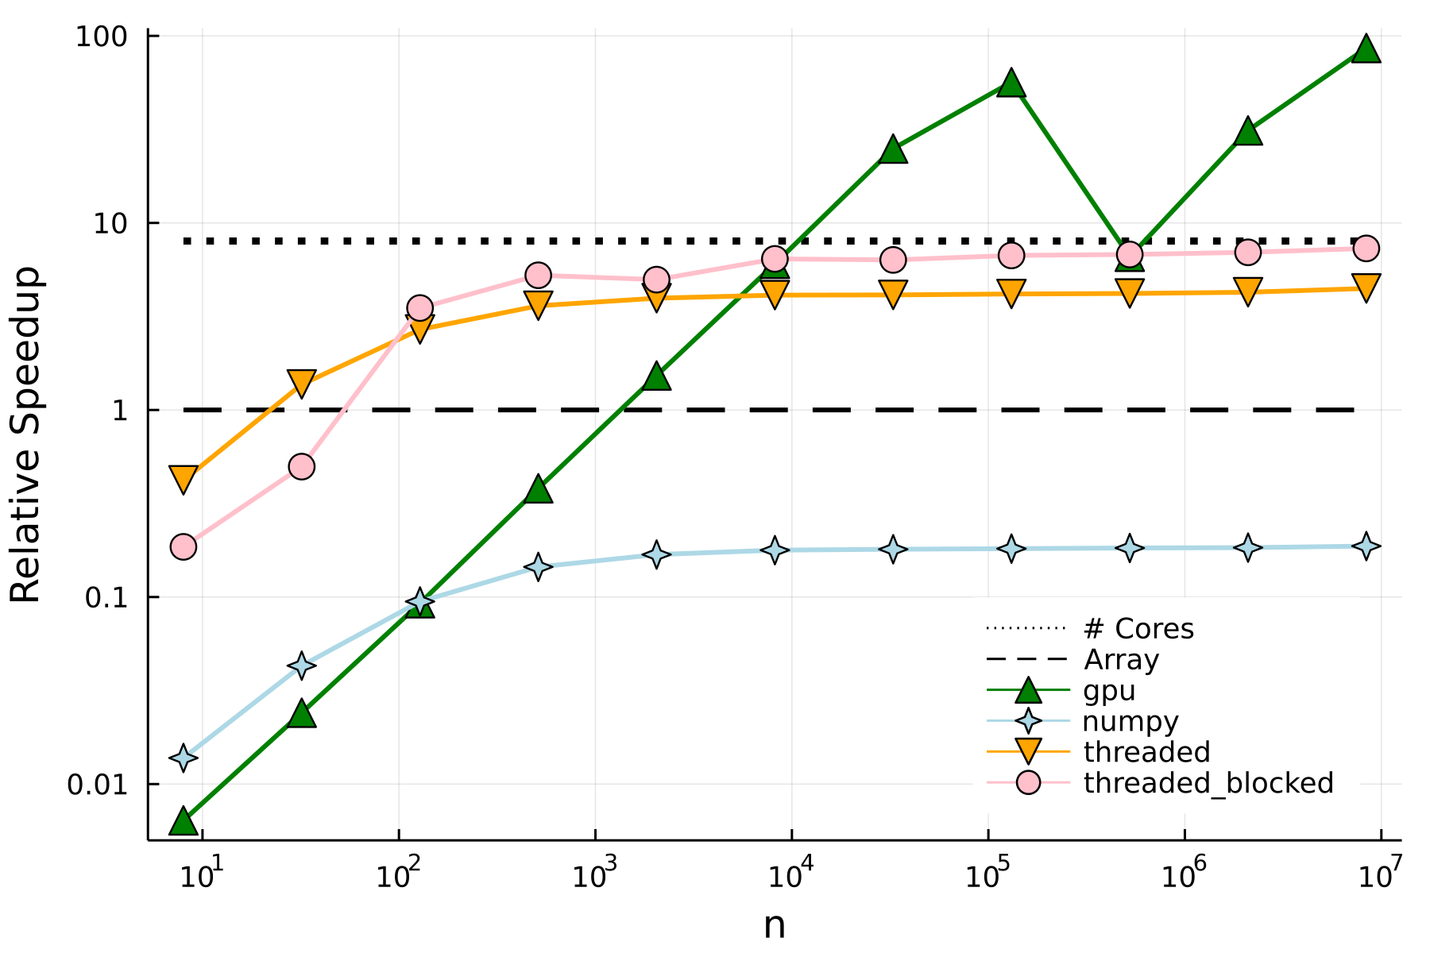
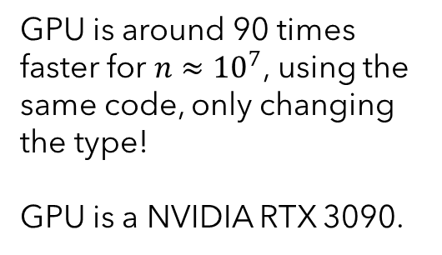
Relative Performance
GPU is around 90 times faster for $n≈{10}^{7}$, using the same code, only changing the type!
GPU is a NVIDIA RTX 3090.

Slide 15
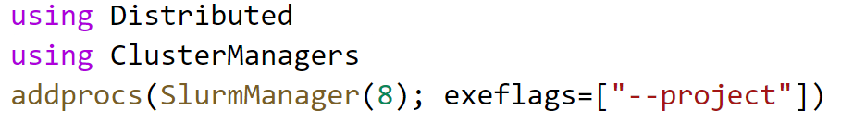

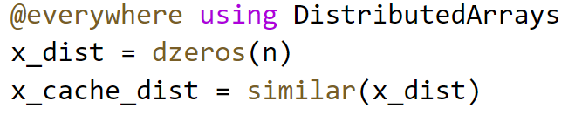
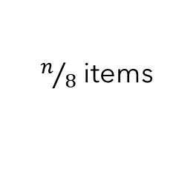

Scaling up to a cluster
On a SLURM cluster
Worker 1
Worker 2
$$⋯$$
Worker 7
Worker 8
Array is split up into 8 parts, one for each worker process.
$n/8$ items

Slide 16
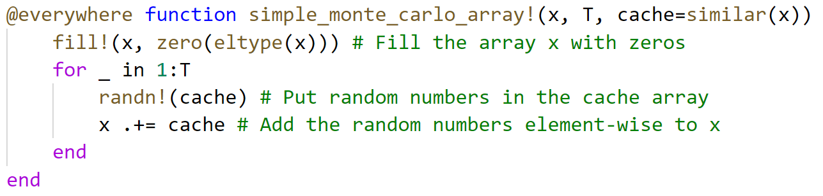
Scaling up to a cluster
1) Make all functions available to each worker, using the @everywhere macro

Slide 17
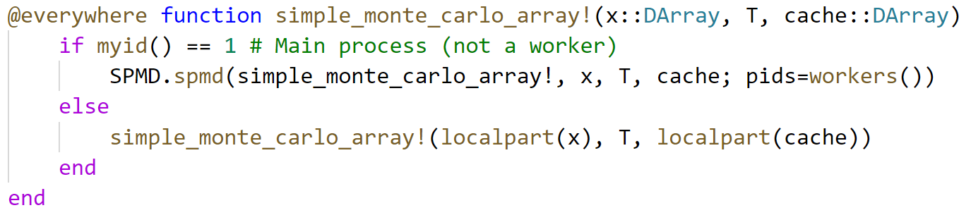
Scaling up to a cluster
2) Specialise on the DArray type, with some boilerplate for Single Program Multiple Data. Lifted from the DistributedArrays.jl documentation.
This code runs our standard array function on each local part of the distributed array. This only affects the function when using DArray datatypes.

Slide 18
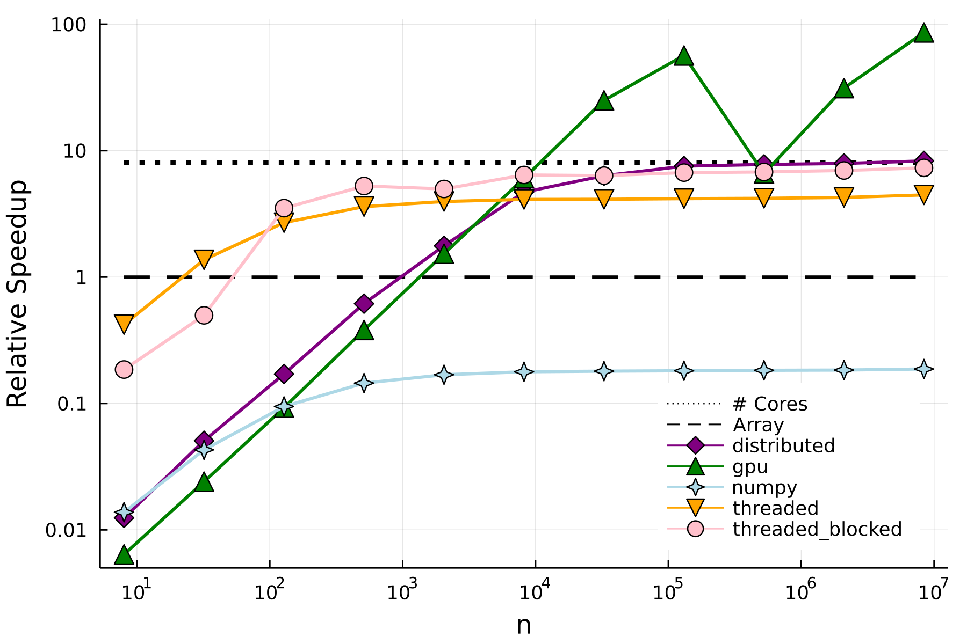
Benchmarks
Distributed implementation approaches maximum speedup, as it follows the same chunk approach as the threaded blocks.

Slide 19
Conclusions
Julia is a fast language, suitable for numerical computing
Has great, lower barrier-to-entry, support for parallel computing at all levels
Compiler specialised on types allows for high-performance and reusable generic code
Is easy to write, prototype and understand!

Slide 20

Thanks for listening!
All code available at https://github.com/JamieMair/julia-for-research-with-hpc
If you want access to the Julia lecture notes, email me at jamie.mair@nottingham.ac.uk
Any questions?

